Slide 1
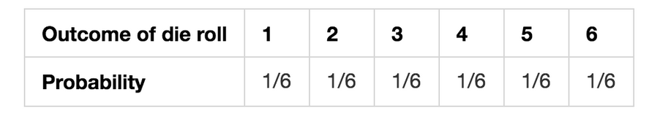
Probability Distribution
A probability distribution is a list of all of the possible outcomes of a random variable along with their corresponding probability values.
Example:
probability distribution of a fair 6-sided die.

Slide 2
Types of Distributions:
Discrete Probability Distribution
Bernoulli Distribution (random variable has only two outcomes)
Binomial Distribution (random variable is sequence of trial of have two outcomes)
Continuous Probability Distribution
Uniform Distribution (equal probability for all outcomes)
Normal Distribution
Poisson Distribution (number of events in a time interval)
Exponential Distribution (time between two events)

Slide 3
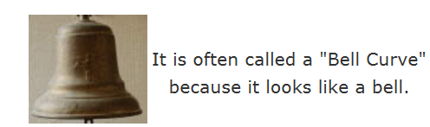
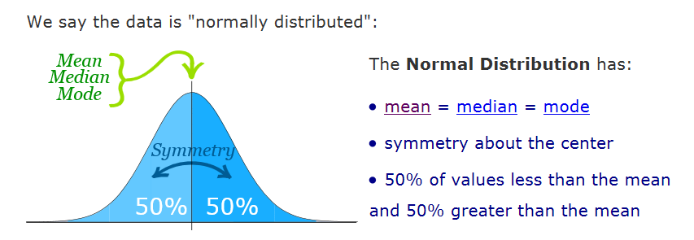
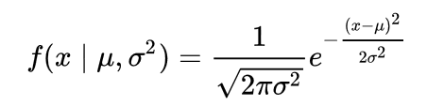
skewness is zero

Slide 4
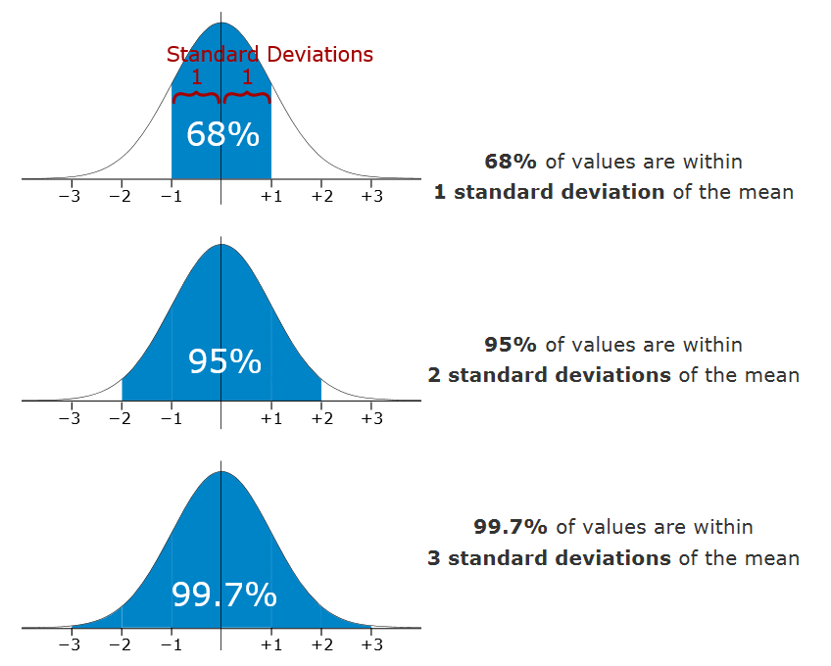
Empirical Rule
The empirical rule tells you what percentage of your data falls within a certain number of standard deviations from the mean:
likely to be within 1 standard deviation (68 out of 100 should be)
very likely to be within 2 standard deviations (95 out of 100 should be)
almost certainly within 3 standard deviations (997 out of 1000 should be)

Slide 5
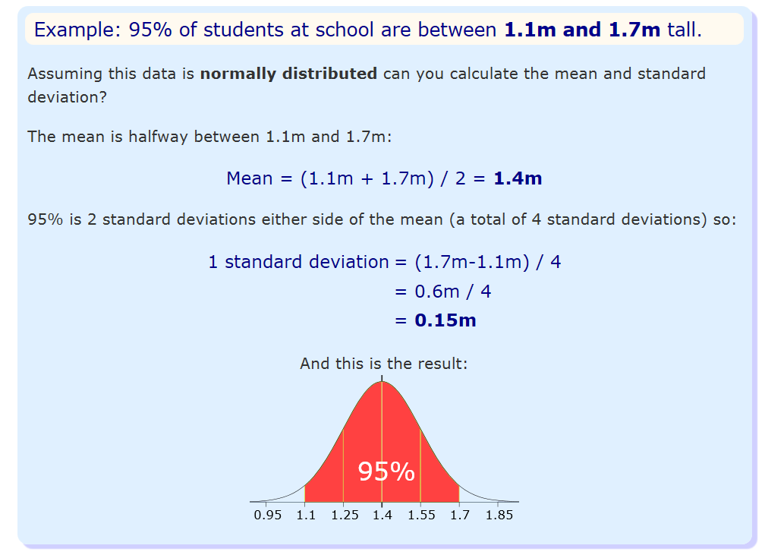

Slide 6
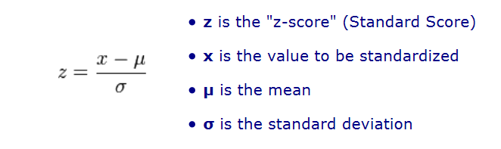
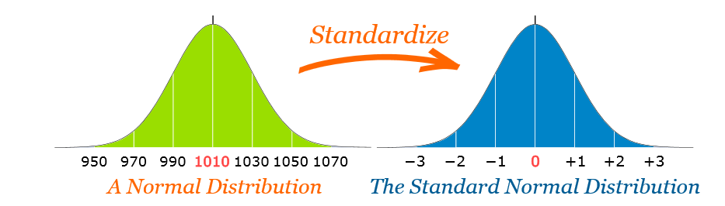
Standard Normal Distribution
Standard normal distribution is a special case of normal distribution where mean = 0 and S.D = 1
Convert a value to a Standard Score ("z-score"):
first subtract the mean, then divide by the Standard Deviation

Slide 7
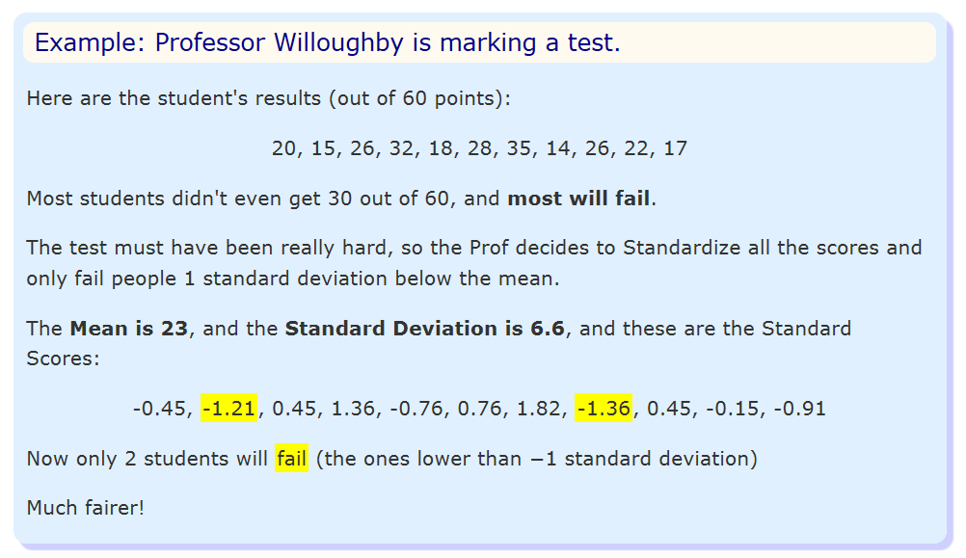

Slide 8
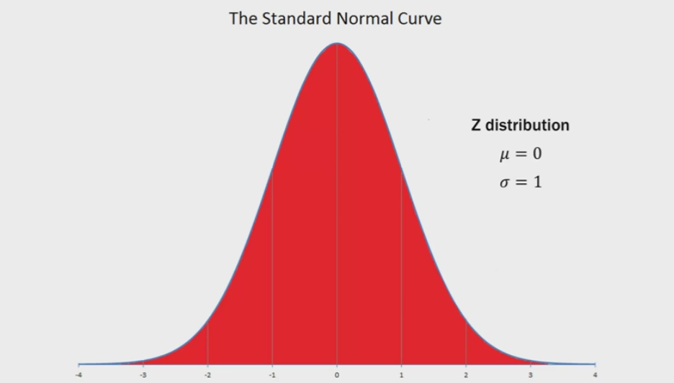
Total probability under the curve is 1 (sum of probability of all outcomes)

Slide 9
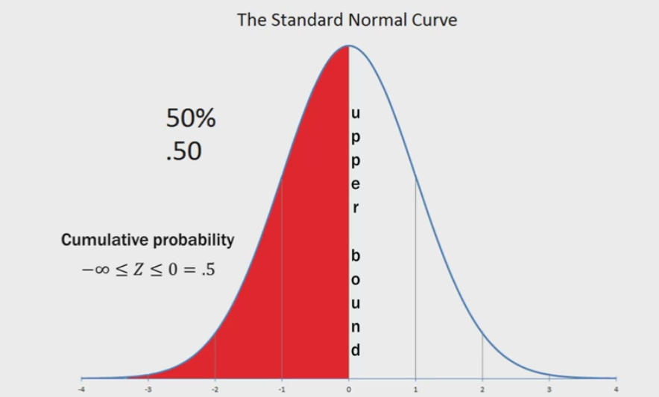

Slide 10
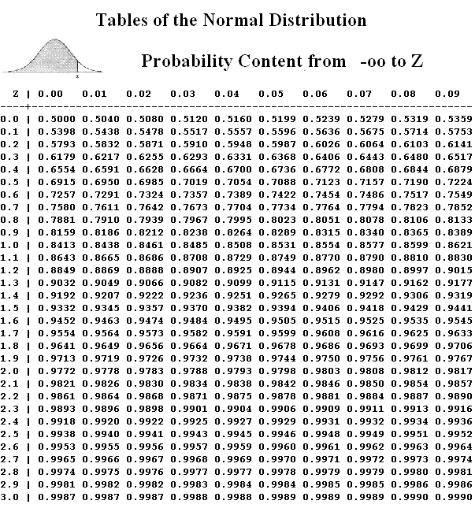
A standard normal distribution table shows a cumulative probability associated with a particular z-score.
Table rows show the whole number and tenths place of the z-score.
Table columns show the hundredths place.
The cumulative probability (often from minus infinity to the z-score) appears in the cell of the table.

Slide 12
P(Z<=0) = 0.5
P(Z<=1.93)= 0.9732
P(Z<=-1.65)= 1- P(1.65) = 1- 0.9505 =0.05

Slide 13
P(-1.65 <Z<=1.93)
P(1.93)= 0.9732
P(-1.65)= 1- P(1.65) = 1- 0.9505 =0.05
P(1.93)- P(-1.65)= 0.9732- 0.05 = 0.93

Slide 14
Use the Standard Normal Distribution table to find
P(0 < Z ≤ 1) = 0.3413
P(-1.65 < Z ≤ 1.93) =0.92
P(0.85 < Z ≤ 2.23) =0.1848
P(Z > 1.75) =0.0401 = 1-P(Z<=1.75)
P(Z ≤ -0.69)= 0.2451
P(-1.27 < Z ≤ 0)=0.398 = P(Z<=0)- Z(Z<= -1.27)
P(Z > -2.64) =0.9959
P(Z ≤ 0.96)=0.8315

Slide 15
norm(loc = 0 , scale = 1).cdf(1.5)
This function gives the probability of a normally distributed random number to be less that the value of a given number. It is also called "Cumulative Distribution Function".
norm(loc = 0 , scale = 1).ppf(0.5)
This function takes the probability value and gives a number whose cumulative value matches the probability value.

Slide 16
P(0.85 < Z ≤ 2.23)
P(Z<=2.23) = 0.9871
P(z<=0.85)= 0.802
P(z<=2.23)- P(z<= 0.85)=

Slide 17
P(Z > 1.75) = 1- P(Z<=1.75)

Slide 18
Why Standardize?
It can help us make decisions about our data.
It also makes life easier because we only need one table (the Standard Normal Distribution Table), rather than doing calculations individually for each value of mean and standard deviation.

Slide 19
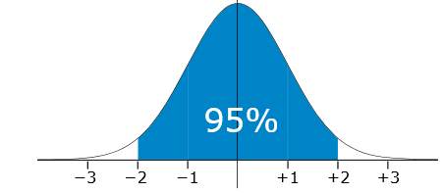
The Taj Tea Company pack tea in bags marked as 250 g A large number of packs of tea were weighed and the mean and standard deviation were calculated as 255 g and 2.5 g respectively. Assuming this data is normally distributed, what percentage of packs are underweight or weigh less than 250g?
P(X<250g)
Z= (250-255)/2.5 = -2
P(-2)= 2.5%

Slide 20
The mean June midday temperature in Kanpur is 36°C and the standard deviation is 3°C. Assuming this data is normally distributed, how many days in June would you expect the midday temperature to be between 39°C and 42°C?
Z1= (39-36)/3 =1
Z2= (42-36)/3= 2
P(Z=2)-P(Z=1)= 0.9772- 0.8413 = 0.1359 , almost 13% of days have temp b/w 39 and 42
No of days= 30*0.1359 =4.08 ~4 days

Slide 21
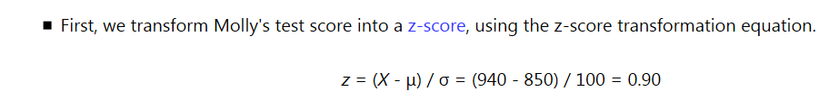
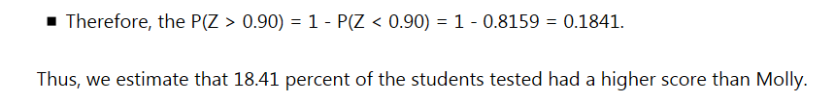
Molly earned a score of 940 on a national achievement test. The mean test score was 850 with a standard deviation of 100. What proportion of students had a higher score than Molly? (Assume that test scores are normally distributed.)
Notes:
https://stattrek.com/probability-distributions/standard-normal.aspx

Slide 22
A machine produces electrical components. 99.7% of the components have lengths between 1.176 cm and 1.224 cm. Assuming this data is normally distributed, what are the mean and standard deviation?
mean- 3SD= 1.176
Mean+3SD=1.224
Mean= (1.176+1.224)/2= 1.2 , SD= (1.224-1.176)/6= 0.008

Slide 23
A company makes parts for a machine. The lengths of the parts must be within certain limits or they will be rejected. A large number of parts were measured and the mean and standard deviation were calculated as 3.1 m and 0.005 m respectively. Assuming this data is normally distributed and 99.7% of the parts were accepted, what are the limits?
3.1-3*0.005 =2.995
3.1+3*0.005=3.115

Slide 24
The heights of male adults are Normally distributed with mean 1.7 m and standard deviation 0.2 m In a population of 400 male adults, how many would you expect to have a height between 1.4 m and 1.6 m?
Z1= (1.4-1.7)/0.2= -1.5
Z2= (1.6-1.7)/0.2= -0.5
P(Z2)-P(Z1) = (1-0.6915) - (1-0.9332) =0.2417
400*0.2417= 96.68 ~97 students

Slide 25
The mean July daily rainfall in Bangalore is 10 mm and the standard deviation is 1.5 mm Assume that this data is normally distributed. How many days in July would you expect the daily rainfall to be less than 8.5 mm?

Slide 26
The ages of the population of a town are Normally distributed with mean 43 and standard deviation 14 The town has a population of 5,000. How many would you expect to be aged between 22 and 57?

